Slide 1
UPPER SIXTH ARTS
GEOGRAPHY
Lesson 21
Solving Inner City Decay
Notes:
Good morning, class, and welcome to our geography lesson. I am your geography teacher, Mr Kamdem. Today we are starting Lesson 21: Solving Inner City Decay.

Slide 2
CLASS INFO
Class, Chapter and Duration
Class | Upper Sixth Arts
Chapter | Module 5: Understanding and managing settlement dynamics across the world in general and Cameroon in particular
Duration | 2 periods (2 × 50 minutes)
Notes:
This lesson is for Upper Sixth Arts. It belongs to Module 5: Understanding and managing settlement dynamics across the world in general and Cameroon in particular. We shall need 2 periods to cover it.

Slide 3
IDENTIFICATION
Lesson Identification
Topic | Problems of Town Growth and Planning
Sub-topic | Planning Inner Cities
Lesson | Lesson 21: Solving Inner City Decay
Notions / Concepts | Inner city decay, urban renewal, redevelopment, gentrification, regeneration.
Syllabus focus | Inner city decay and urban renewal in inner cities.
Competence | Learners are able to explain inner city decay and evaluate urban renewal.
Notes:
Our topic is Problems of Town Growth and Planning, and the sub-topic is Planning Inner Cities. The key notions we shall use today are: inner city decay, urban renewal, redevelopment, gentrification, regeneration. At the end, you should be able to do this: learners are able to explain inner city decay and evaluate urban renewal.

Slide 4

HOMEWORK CORRECTION
Correction of the Homework
Question (Lesson 20: Settlement Planning):
Suggest a plan to solve one problem in your quarter.
Notes:
Before we start the new lesson, let us correct the homework I gave you at the end of Lesson 20: Settlement Planning. The question was: Suggest a plan to solve one problem in your quarter. Take out your exercise books.

Slide 5
HOMEWORK CORRECTION
Correction: Possible Answer
Example: our quarter floods every rainy season; plan – clean the drains monthly, build a wider concrete drain, stop building on the stream bed and plant grass on bare land.
Notes:
Here is a good answer. Example: our quarter floods every rainy season; plan – clean the drains monthly, build a wider concrete drain, stop building on the stream bed and plant grass on bare land. Compare it with your own answer and correct your work in red.

Slide 6
LESSON PLAN
Lesson Plan
Correction of the homework
Objectives and recall
Real-life situation and action to take
Learning activities
Board summary
Evaluation, remediation and homework
Notes:
Here is the plan of our lesson today. First, we shall correct the homework. Then we shall look at the objectives and recall what you already know. After that, we shall study a situation from real life and the action to take, and do the learning activities. Finally, we shall copy the board summary, do the evaluation and the remediation, and I will give you the homework.

Slide 7
OBJECTIVES
Objectives
By the end of this lesson, you should be able to:
Describe inner city decay and its causes.
Explain urban renewal and its stages.
Evaluate a renewal scheme.
Notes:
By the end of this lesson, you should be able to do three things. Number 1: describe inner city decay and its causes. Number 2: explain urban renewal and its stages. Number 3: evaluate a renewal scheme.

Slide 8
PREVIOUS KNOWLEDGE
Previous Knowledge
The inner city surrounds the CBD.
People moved out to the suburbs.
Notes:
Let us first remember what you already know. The inner city surrounds the CBD. People moved out to the suburbs. Keep this in mind, because we shall build on it today.

Slide 9
REAL-LIFE SITUATION
Situation in Real Life
In London, the old docks closed in the 1970s and the area became empty and poor. Today it has tall offices, new flats and a light railway. Learners ask if everyone benefited.
Notes:
Listen carefully to this situation from real life. In London, the old docks closed in the 1970s and the area became empty and poor. Today it has tall offices, new flats and a light railway. Learners ask if everyone benefited. Think about it, because I am going to ask you some questions.

Slide 10
REAL-LIFE SITUATION
Situation: Question 1
What is the problem in the situation?
Notes:
Question 1: What is the problem in the situation? Think for a moment, then raise your hand to answer.

Slide 11
REAL-LIFE SITUATION
Answer
An old inner area declined and was then rebuilt.
Notes:
Good. An old inner area declined and was then rebuilt.

Slide 12
REAL-LIFE SITUATION
Situation: Question 2
What is the decline called?
Notes:
Question 2: What is the decline called? Think for a moment, then raise your hand to answer.

Slide 13
REAL-LIFE SITUATION
Answer
Inner city decay.
Notes:
Good. Inner city decay.

Slide 14
REAL-LIFE SITUATION
Situation: Question 3
What is the rebuilding called?
Notes:
Question 3: What is the rebuilding called? Think for a moment, then raise your hand to answer.

Slide 15
REAL-LIFE SITUATION
Possible Answer
Urban renewal.
Notes:
Good. Urban renewal.

Slide 16
ACTION TO TAKE
Action to Take
Renew old quarters while protecting their inhabitants.
Notes:
From this situation, the action we are working towards in this lesson is the following: renew old quarters while protecting their inhabitants.

Slide 17
JUSTIFICATION
Justification of the Lesson
This lesson helps us to understand how old city areas can be revived.
Notes:
Why is this lesson important for you? This lesson helps us to understand how old city areas can be revived.

Slide 18

1. INNER CITY DECAY
Activity 1
Old, crowded housing.
Notes:
Activity 1. Look carefully at this picture: old, crowded housing. Observe every detail before I ask the question.

Slide 19
1. INNER CITY DECAY
Activity 1: Question
Give two signs of inner city decay.
Notes:
Here is the question for Activity 1: Give two signs of inner city decay. Take one minute to think and write your answer in your rough notebook.

Slide 20
1. INNER CITY DECAY
Activity 1: Answer
Old, crowded houses and empty factories (also poverty, crime).
Notes:
Let us check the answer together. Old, crowded houses and empty factories (also poverty, crime).

Slide 21

1. CAUSES OF DECAY
Activity 2
Suburbs.
Notes:
Activity 2. Look carefully at this picture: suburbs. Observe every detail before I ask the question.

Slide 22
1. CAUSES OF DECAY
Activity 2: Question
Why did inner cities decline in MEDCs?
Notes:
Here is the question for Activity 2: Why did inner cities decline in MEDCs? Take one minute to think and write your answer in your rough notebook.

Slide 23
1. CAUSES OF DECAY
Activity 2: Answer
Factories closed and richer people moved to the suburbs.
Notes:
Let us check the answer together. Factories closed and richer people moved to the suburbs.

Slide 24
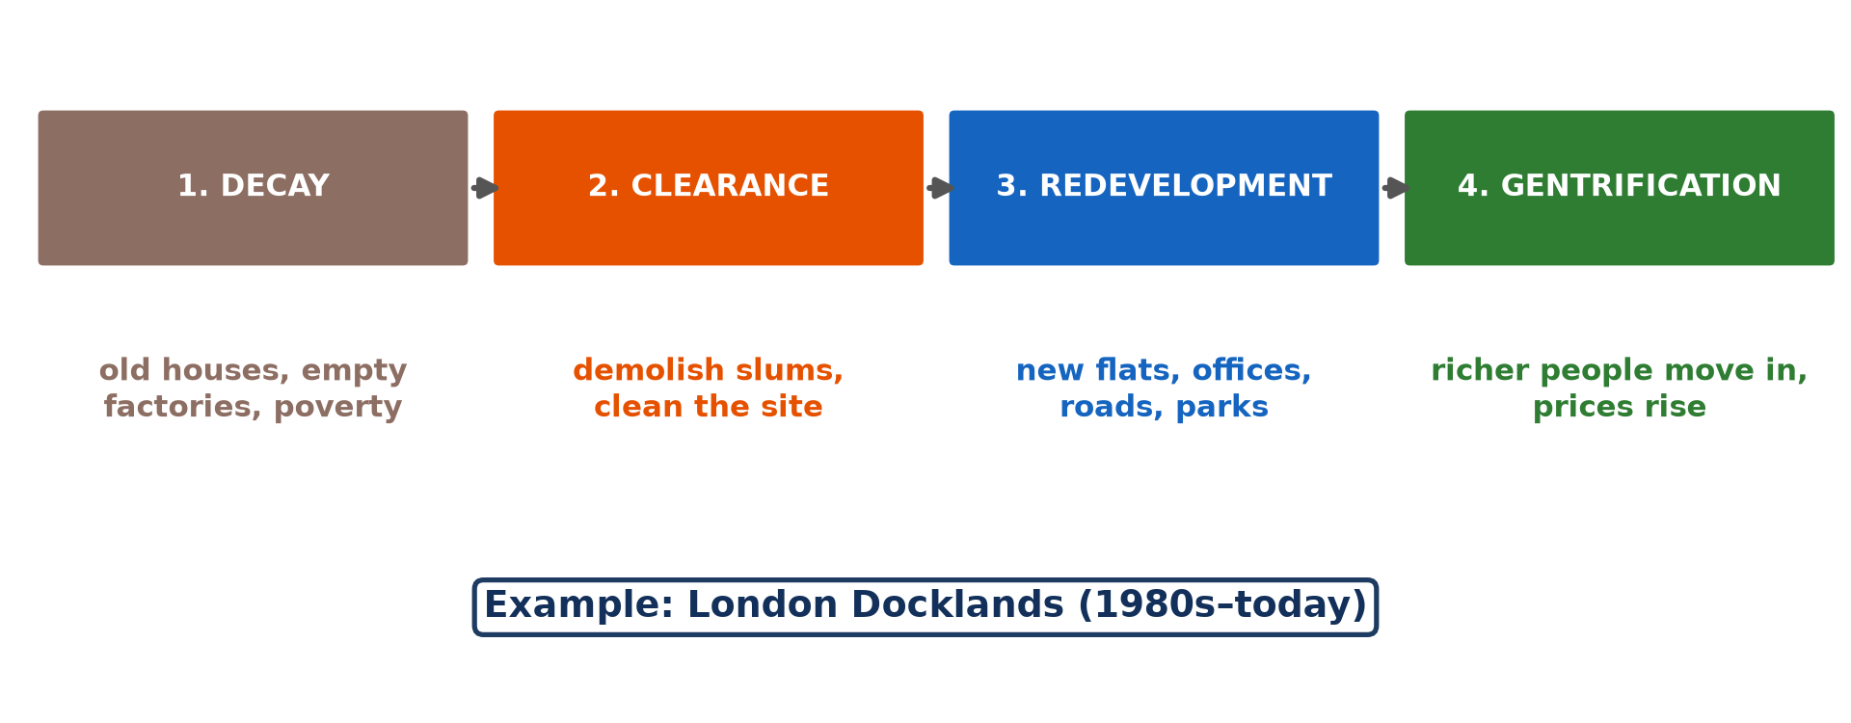
2. URBAN RENEWAL
Activity 3
Stages of urban renewal.
Notes:
Activity 3. Look carefully at this diagram: stages of urban renewal. Observe every detail before I ask the question.

Slide 25
2. URBAN RENEWAL
Activity 3: Question
What happens during redevelopment?
Notes:
Here is the question for Activity 3: What happens during redevelopment? Take one minute to think and write your answer in your rough notebook.

Slide 26
2. URBAN RENEWAL
Activity 3: Answer
New flats, offices, roads and parks are built.
Notes:
Let us check the answer together. New flats, offices, roads and parks are built.

Slide 27
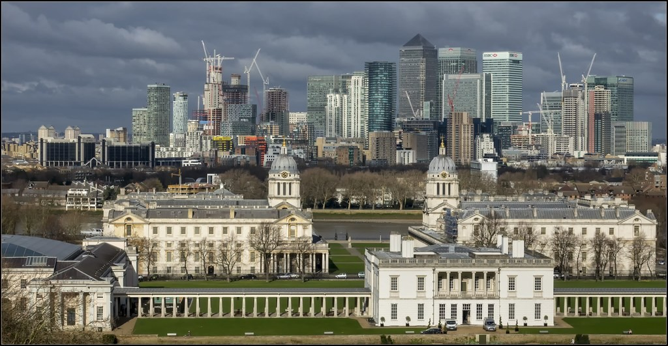
2. EXAMPLE: LONDON DOCKLANDS
Activity 4
London Docklands today.
Notes:
Activity 4. Look carefully at this picture: london Docklands today. Observe every detail before I ask the question.

Slide 28
2. EXAMPLE: LONDON DOCKLANDS
Activity 4: Question
Give one success and one problem of the Docklands scheme.
Notes:
Here is the question for Activity 4: Give one success and one problem of the Docklands scheme. Take one minute to think and write your answer in your rough notebook.

Slide 29
2. EXAMPLE: LONDON DOCKLANDS
Activity 4: Answer
Success: new jobs and offices. Problem: local people could not afford new homes.
Notes:
Let us check the answer together. Success: new jobs and offices. Problem: local people could not afford new homes.

Slide 30

2. RENEWAL IN CAMEROON
Activity 5
Douala.
Notes:
Activity 5. Look carefully at this picture: douala. Observe every detail before I ask the question.

Slide 31
2. RENEWAL IN CAMEROON
Activity 5: Question
How are old quarters renewed in Cameroon?
Notes:
Here is the question for Activity 5: How are old quarters renewed in Cameroon? Take one minute to think and write your answer in your rough notebook.

Slide 32
2. RENEWAL IN CAMEROON
Activity 5: Answer
Demolition of slums and building of roads and estates (with compensation problems).
Notes:
Let us check the answer together. Demolition of slums and building of roads and estates (with compensation problems).

Slide 33
BOARD SUMMARY
Board Summary
Topic: Problems of Town Growth and Planning
Sub-topic: Planning Inner Cities
Lesson 21: Solving Inner City Decay
Notes:
Now we are going to copy the board summary. Write the title and the headings neatly in your notebooks. I will give you enough time for each slide, so do not rush.

Slide 34
BOARD SUMMARY
DEFINITIONS
The key terms of this lesson are defined as follows:
Inner city decay: It is the decline of the old areas near the city centre.
Urban renewal: It is the improvement of decayed urban areas by redevelopment or rehabilitation.
Notes:
Let us copy the definitions. The key terms of this lesson are defined as follows. On this slide we have Inner city decay and Urban renewal. Write each point on a new line, with the key term first, and explain it in your own words when we revise.

Slide 35
BOARD SUMMARY
1. Inner City Decay
Inner city decay can be studied as follows:
Signs: Old, overcrowded houses, empty factories, derelict land, unemployment and crime are signs of decay. Services decline.
Notes:
Let us copy Inner City Decay. Inner city decay can be studied as follows. On this slide we have Signs. Write each point on a new line, with the key term first, and explain it in your own words when we revise. When you finish, we go to the next slide.

Slide 36
BOARD SUMMARY
1. Inner City Decay (continued)
Causes: Industries closed or moved to the suburbs, and richer people left for better housing. Poor migrants remained in old buildings.
Notes:
We continue with Inner City Decay. On this slide we have Causes. Write each point on a new line, with the key term first, and explain it in your own words when we revise.

Slide 37
BOARD SUMMARY
2. Urban Renewal in Inner Cities
Inner cities are renewed in the following ways:
Redevelopment: Old buildings are demolished and replaced by new housing, offices and roads. It is fast but displaces residents.
Notes:
Let us copy Urban Renewal in Inner Cities. Inner cities are renewed in the following ways. On this slide we have Redevelopment. Write each point on a new line, with the key term first, and explain it in your own words when we revise. When you finish, we go to the next slide.

Slide 38
BOARD SUMMARY
2. Urban Renewal in Inner Cities (continued)
Rehabilitation: Old houses are repaired and modernised, and services improved. It keeps the community in place.
Notes:
We continue with Urban Renewal in Inner Cities. On this slide we have Rehabilitation. Write each point on a new line, with the key term first, and explain it in your own words when we revise. When you finish, we go to the next slide.

Slide 39
BOARD SUMMARY
2. Urban Renewal in Inner Cities (continued)
Examples: The London Docklands were transformed into offices, housing and transport links, but some local people could not afford the new houses. In Cameroon, old quarters of Douala and Yaoundé are restructured with new roads and drains.
Notes:
We continue with Urban Renewal in Inner Cities. On this slide we have Examples. Write each point on a new line, with the key term first, and explain it in your own words when we revise.

Slide 40
BOARD SUMMARY
2. Urban Renewal in Inner Cities
Illustration: urban renewal
Notes:
Now draw this illustration in your notebook: urban renewal. Give it a title and label it clearly.

Slide 41
FORMATIVE EVALUATION
Evaluation 1
Give two causes of inner city decay.
Notes:
Now let us check what you have understood. Question 1: Give two causes of inner city decay. Answer in your exercise book.

Slide 42
FORMATIVE EVALUATION
Expected Answer
Closure of industries and movement of people to the suburbs.
Notes:
The expected answer is: closure of industries and movement of people to the suburbs. If you got it right, well done.

Slide 43
FORMATIVE EVALUATION
Evaluation 2
Give one advantage and one disadvantage of urban renewal.
Notes:
Now let us check what you have understood. Question 2: Give one advantage and one disadvantage of urban renewal. Answer in your exercise book.

Slide 44
FORMATIVE EVALUATION
Expected Answer
Advantage: better environment and jobs. Disadvantage: poor local people pushed out.
Notes:
The expected answer is: advantage: better environment and jobs. Disadvantage: poor local people pushed out. If you got it right, well done.

Slide 45
REMEDIATION
Remediation
Fill in the blanks:
The decline of old central areas is inner city ______.
Rebuilding old areas is urban ______.
Richer people moving into renewed areas is ______.
Notes:
For those who need more practice, fill in the blanks in your exercise book. The answers are: number 1, decay; number 2, renewal; number 3, gentrification.

Slide 46
HOMEWORK
Homework
Identify an old quarter in your town and suggest how it could be renewed.
Notes:
For your homework: Identify an old quarter in your town and suggest how it could be renewed. We shall correct it at the beginning of our next lesson.

Slide 47
NEXT LESSON
Next Lesson
Our next lesson will be on:
Lesson 22: Controlling Town Spread
Notes:
Our next lesson will be on Lesson 22: Controlling Town Spread. Thank you for your attention, and see you next time.

Slide 48
BILINGUAL GAME
Bilingual Game (Jeu Bilingue)
English | Français
Decay | La dégradation
Renewal | La rénovation urbaine
Demolition | La démolition
Docks | Les docks
Gentrification | La gentrification
Compensation | L'indemnisation
Notes:
Let us play the bilingual game. I say a word in English, and you give me the French word. Then we do the reverse.

Slide 49
LOGBOOK
Official Logbook (1/2)
Module / Topic | Problems of Town Growth and Planning
Lesson Title | Lesson 21: Solving Inner City Decay
Expected Learning Outcomes | Describe inner city decay and its causes. Explain urban renewal and its stages. Evaluate a renewal scheme.
Competence | Learners are able to explain inner city decay and evaluate urban renewal.
Notes:
I record this information in the official logbook of the class after the lesson.

Slide 50
LOGBOOK
Official Logbook (2/2)
Matter Taught | DEFINITIONS; Inner City Decay; Urban Renewal in Inner Cities.
Evaluation | Formative evaluation and remediation exercise.
Homework | Identify an old quarter in your town and suggest how it could be renewed.
Enrolment / Present / Absent | ____ / ____ / ____
Achievement | To be completed after the lesson.
Notes:
I complete the second page of the logbook: the matter taught, the evaluation, the homework and the attendance.

Slide 51
TEACHER'S NOTE
Teacher's Note
Timing: Homework correction, plan, objectives 8 min | Recall, situation, action 10 min | 5 activities 30 min | Board summary (copying) 30 min | Evaluation, remediation 10 min | Homework, next lesson 5 min | Logbook 7 min
Without the projector (Activity 1): list signs.
Without the projector (Activity 2): link to suburbanisation.
Without the projector (Activity 3): draw the four stages.
Without the projector (Activity 4): discuss winners and losers.
Without the projector (Activity 5): discuss demolitions.
Notes:
This slide is for me, the teacher: it gives the timing of the lesson and what to do if the projector is not available.

Slide 52
REFERENCES
References
National Geography Syllabus, MINESEC/IGE/IP-SS, 2019 — Module 5 (Settlement Geography).
Photo, Activity 1: “Mathare” by Book Aid International, CC BY-NC-ND 2.0, via Flickr (https://www.flickr.com/photos/45024905@N07/4135561707)
Photo, Activity 2: “Chicago suburbs from the air” by Scorpions and Centaurs, CC BY-NC-SA 2.0, via Flickr (https://www.flickr.com/photos/62736719@N00/2912708983)
Photo, Activity 4: “Old & new: University Greenwich, The Queen's House & London Docklands” by Bert Kaufmann, CC BY-NC 2.0, via Flickr (https://www.flickr.com/photos/22746515@N02/26742366958)
Photo, Activity 5: “Douala” by christing-O-, CC BY 2.0, via Flickr (https://www.flickr.com/photos/76187282@N00/7227535754)
Diagrams and animations: drawn for this lesson (Geography Department).
Notes:
These are the references and picture credits used to prepare this lesson.

